Slide 1

Android 新技术趋势
xuezhangbin@bytedance.com - 字节跳动 Android 工程师
Notes:
自我介绍 回顾历史 细分领域 业务开发演进趋势 开课目的

Slide 2

Android 新技术趋势
2021.07.19

Slide 3

目录
High-efficient development: Jetpack
Functional programming: Kotlin
Cross-platform framework: Flutter
Notes:
开源社区活跃，技术演进快，Google 主导

Slide 4

Jetpack
https://developer.android.com/jetpack/

Slide 5
Jetpack
Jetpack is a collection of Android software components to make it easier for you to develop great Android apps.
Notes:
不全是新的东西，多年演化和积累的结果

Slide 6
Jetpack
These components help you
Follow best practices
Eliminate boilerplate code
Build high quality, robust apps
Notes:
核心是提升效率

Slide 7

Jetpack
Foundation
AppCompat
Android KTX
Multidex
Test

Slide 8

Jetpack
Architecture
Data Binding
Lifecycles
LiveData
Navigation
Paging
Room
ViewModel
WorkManager

Slide 9

Jetpack
Behavior
Download manager
Media & playback
Notifications
Permissions
Preferences
Sharing
Slices

Slide 10

Jetpack
UI
Animation & transitions
Auto
Emoji
Fragment
Layout
Palette
TV
Wear OS by Google

Slide 11
Architecture
MVC
MVP
MVVM
Samples:
https://github.com/googlesamples/android-architecture

Slide 12
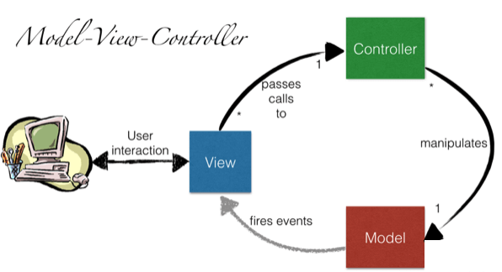
Architecture

Slide 13
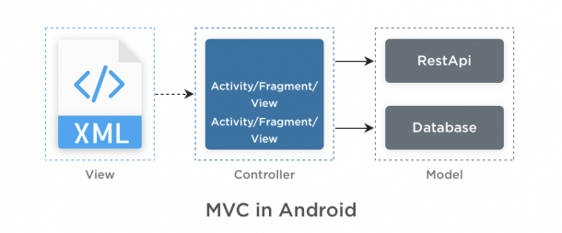
Architecture

Slide 14
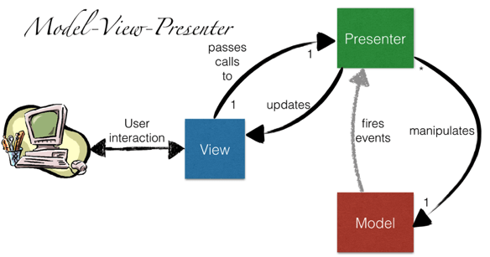
Architecture

Slide 15
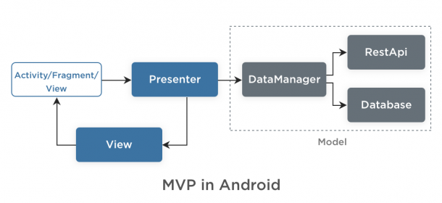
Architecture

Slide 16
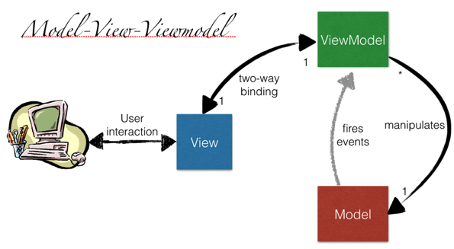
Architecture

Slide 17
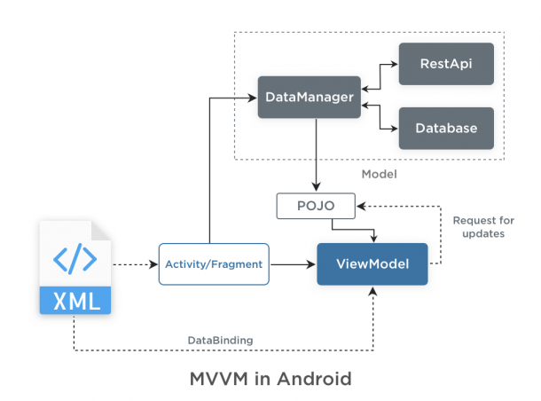
Architecture

Slide 18
LiveData

Slide 19
LiveData
Without LiveData
// ViewModel
List<User> userList;
List<UserLoadedListener> listeners = new ArrayList<>()
void registerListener(UserLoadedListener lsn) {
listeners.add(lsn)
}
void unregisterListener(UserLoadedListener lsn) {
listeners.remove(lsn)
}
void loadUsers() {
userService.getUsers(data -> {
userList = data;
// notify UI
for(UserLoadedListener lsn : listeners) {
lsn.onUserLoaded(userList);
}
})
}
// Activity
UserLoadedListener listener = data -> {
// update UI
}
// onCreate
userViewModel.registerListener(userListener);
userViewModel.loadUsers();
…
//onDestroy
userViewModel.unregisterListener(listener);

Slide 20
LiveData
With LiveData
// ViewModel
private MutableLiveData<List<User>> users;
public LiveData<List<User>> getUsers() {
if (users == null) {
users = new MutableLiveData<List<User>>();
userRepository.loadUsers(data -> {
userList.setValue(data);
})
}
return users;
}
// Activity
getUsers().observe(this, users -> {
// update UI
});

Slide 21
LiveData
Transformations
// map
LiveData<User> userLiveData = ...;
LiveData<String> userName = Transformations.map(userLiveData, user -> {
user.name + " " + user.lastName
});
// switchMap
private LiveData<User> getUser(String id) {
...;
}
LiveData<String> userId = ...;
LiveData<User> user = Transformations.switchMap(userId, id -> getUser(id) );

Slide 22
ViewModel

Slide 23
ViewModel
public class UserViewModel extends ViewModel {
private MutableLiveData<List<User>> users;
public LiveData<List<User>> getUsers() {
if (users == null) {
users = new MutableLiveData<List<User>>();
userRepository.loadUsers(data -> {
userList.setValue(data);
})
}
return users;
}
}

Slide 24
ViewModel
public class UserActivity extends AppCompatActivity {
@Override
public void onCreate(Bundle savedInstanceState) {
UserViewModel model = ViewModelProviders.of(this).get(UserViewModel.class);
model.getUsers().observe(this, users -> {
// update UI
});
}
}

Slide 25
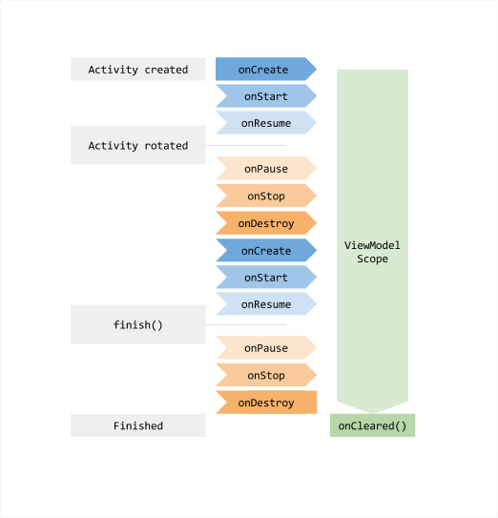
ViewModel

Slide 26
Lifecycles

Slide 27
Lifecycles
public class UserActivity extends AppCompatActivity {
@Override
public void onCreate(Bundle savedInstanceState) {
UserViewModel model = ViewModelProviders.of(this).get(UserViewModel.class);
model.getUsers().observe(this, users -> {
// update UI
});
}
}

Slide 28
Lifecycles
Fragments and Activities in Support Library 26.1.0 and later already implement the LifecycleOwner interface.
class AppCompatActivity extends Activity implements LifecycleOwner
class Fragment implements LifecycleOwner

Slide 29
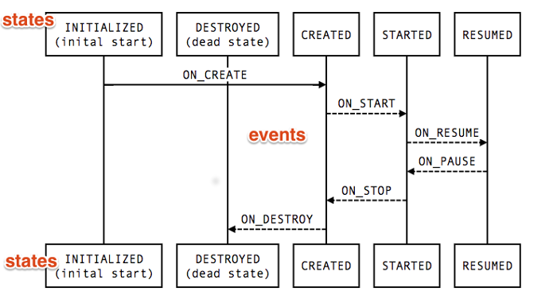
Lifecycles

Slide 30
Lifecycles
Activated

Slide 31
DataBinding

Slide 32
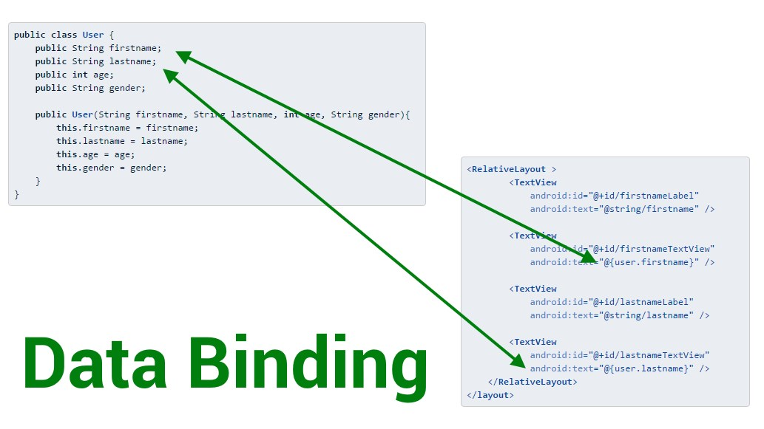
DataBinding

Slide 33
DataBinding
ViewModel
class UserModel extends ViewModel {
public final MutableLiveData<String> nickName = new MutableLiveData<>();
public final MutableLiveData<Integer> age = new MutableLiveData<>();
...
}

Slide 34
DataBinding
XML
<layout xmlns:android="http://schemas.android.com/apk/res/android">
<data>
<variable name="user" type="com.example.UserModel"/>
</data>
...
<TextView android:layout_width="wrap_content"
android:layout_height="wrap_content"
android:text="@{user.nickName}" />
...
</layout>

Slide 35
DataBinding
Activity
class UserActivity : AppCompatActivity() {
override fun onCreate(savedInstanceState: Bundle?) {
UserModel userModel = ViewModelProviders.of(getActivity()).get(UserModel.class)
val binding: UserBinding = DataBindingUtil.setContentView(this, R.layout.user)
binding.setLifecycleOwner(this)
binding.viewmodel = userModel
}
}

Slide 36
LiveData
LiveData
ViewModel
Lifecycles
Data Binding

Slide 37

Kotlin
https://kotlinlang.org/

Slide 38
Kotlin
A statically typed, cross-platform, general-purpose programming language with type inference.
Mainly targets the JVM, but also compiles to JavaScript or native code (via LLVM).
Sponsored by JetBrains, a software development company based in Prague, and is also backed by Google under the Kotlin Foundation.

Slide 39
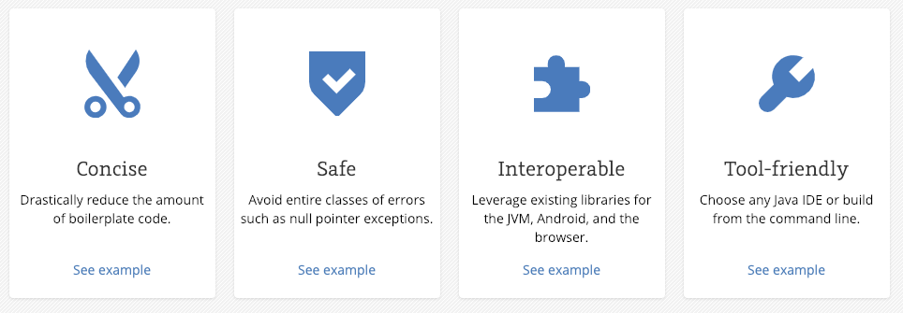
Why Kotlin

Slide 40
Null Safety
// Java
void int getLastNameLength(User user) {
if (user != null
&& user.info != null
&& user.info.basicInfo != null
&& user.info.basicInfo.name != null
&& user.info.basicInfo.name.lastName != null) {
return user.info.basicInfo.name.lastName.length();
} else {
return -1;
}
}

Slide 41
Null Safety
// Java
void int getLastNameLength(User user) {
if (user != null
&& user.info != null
&& user.info.basicInfo != null
&& user.info.basicInfo.name != null
&& user.info.basicInfo.name.lastName != null) {
return user.info.basicInfo.name.lastName.length();
} else {
return -1;
}
}
// Kotlin
fun getLastNameLength(val user: User?)
= user?.info?.basicInfo?.name?.lastName?.length() ?: -1

Slide 42
Default Arguments
// Java
class View {
public View(Context context) { … }
public View(Context context, @Nullable AttributeSet attrs) {
this(context, attrs, 0);
}
public View(Context context, @Nullable AttributeSet attrs,
int defStyleAttr) {
this(context, attrs, defStyleAttr, 0);
}
public View(Context context, @Nullable AttributeSet attrs,
int defStyleAttr, int defStyleRes) {
this(context);
...
}
}

Slide 43
Default Arguments
// Java
class View {
public View(Context context) { … }
public View(Context context, @Nullable AttributeSet attrs) {
this(context, attrs, 0);
}
public View(Context context, @Nullable AttributeSet attrs,
int defStyleAttr) {
this(context, attrs, defStyleAttr, 0);
}
public View(Context context, @Nullable AttributeSet attrs,
int defStyleAttr, int defStyleRes) {
this(context);
...
}
}
// Kotlin
class View(context: Context, attrs: AttributeSet? = null, defStyleAttr: Int = 0,
defStyleRes: Int = 0)

Slide 44
Lazy Initiation
// Java
private MediaPlayer mPlayer;
public synchronized void play(String url) {
if (mPlayer == null) {
mPlayer = createPlayer();
}
mPlayer.play(url);
}

Slide 45
Lazy Initiation
// Java
private MediaPlayer mPlayer;
public synchronized void play(String url) {
if (mPlayer == null) {
mPlayer = createPlayer();
}
mPlayer.play(url);
}
// Kotlin
private val mPlayer: MediaPlayer by lazy {
createPlayer()
}
fun play(val url: String) {
mPlayer.play(url)
}

Slide 46
Data class
// Java
class User {
public final String firstName;
public final String lastName;
public final int age;
public final String avatarUrl;
public final List<User> friends;
public User(String firstName, String lastName,
int age, List<User> friends) {
this.firstName = firstName;
this.lastName = lastName;
this.age = age;
this.avatarUrl = avatarUrl;
this.friends = friends;
}
}

Slide 47
Data class
// Java
class User {
public final String firstName;
public final String lastName;
public final int age;
public final String avatarUrl;
public final List<User> friends;
public User(String firstName, String lastName,
int age, List<User> friends) {
this.firstName = firstName;
this.lastName = lastName;
this.age = age;
this.avatarUrl = avatarUrl;
this.friends = friends;
}
}
// Kotlin
data class User(val firstName: String, val lastName: String,
val age: Int, val avatarUrl: String, val List<User> friends)

Slide 48
Data class
// Java
User mUser;
…
void onAvatarUpdated(String newAvatarUrl) {
List<User> friends = new ArrayList<>();
for (User user : mUser.friends) {
friends.add(user);
}
mUser = new User(mUser.firstName, mUser.lastName,
mUser.age, newAvatarUrl, friends)
}

Slide 49
Data class
// Java
User mUser;
…
void onAvatarUpdated(String newAvatarUrl) {
List<User> friends = new ArrayList<>();
for (User user : mUser.friends) {
friends.add(user);
}
mUser = new User(mUser.firstName, mUser.lastName,
mUser.age, newAvatarUrl, friends)
}
// Kotlin
var mUser
newAvartarUrl -> {
mUser = mUser.copy(avatarUrl = newAvatarUrl)
}

Slide 50
Extension Functions
// Java
public class SwapableArrayList<T> extends ArrayList<T> {
public void swap(int index1, int index2) {
T temp = get(index1);
set(index1, get(index2));
set(index2, temp);
}
}

Slide 51
Extension Functions
// Java
public class SwapableArrayList<T> extends ArrayList<T> {
public void swap(int index1, int index2) {
T temp = get(index1);
set(index1, get(index2));
set(index2, temp);
}
}
// Kotlin
fun MutableList<Int>.swap(index1: Int, index2: Int) {
val tmp = this[index1]
this[index1] = this[index2]
this[index2] = tmp
}

Slide 52
Extension Properties
// Java
public class LastIndexArrayList<T> extends ArrayList<T> {
public void getLastIndex() {
return getSize() - 1;
}
}

Slide 53
Extension Properties
// Java
public class LastIndexArrayList<T> extends ArrayList<T> {
public void getLastIndex() {
return getSize() - 1;
}
}
// Kotlin
val <T> List<T>.lastIndex: Int
get() = size - 1

Slide 54
Extension Properties
// Java
public class LastIndexArrayList<T> extends SwapableArrayList<T> {
public void getLastIndex() {
return getSize() - 1;
}
}
// Kotlin
val <T> List<T>.lastIndex: Int
get() = size - 1

Slide 55
When Expression
// Kotlin
when (x) {
1 -> print("x == 1")
2 -> print("x == 2")
else -> { // Note the block
print("x is neither 1 nor 2")
}
}

Slide 56
When Expression
// Kotlin
when (x) {
1 -> print("x == 1")
2 -> print("x == 2")
else -> { // Note the block
print("x is neither 1 nor 2")
}
}
// Java
switch(x) {
case 1:
print("x == 1");
break;
case 2:
print("x == 2");
break;
default:
print("x is neither 1 nor 2");
break;
}

Slide 57
When Expression
// Kotlin
when (x) {
in 1..10 -> print("x is in the range")
in validNumbers -> print("x is valid")
!in 10..20 -> print("x is outside the range")
else -> print("none of the above")
}

Slide 58

When Expression
// Kotlin
when (x) {
in 1..10 -> print("x is in the range")
in validNumbers -> print("x is valid")
!in 10..20 -> print("x is outside the range")
else -> print("none of the above")
}
// Java

Slide 59
Functional Programming
Kotlin functions are first-class, which means that they can be stored in variables and data structures, passed as arguments to and returned from other higher-order functions.

Slide 60
Functional Programming
// OOP
class Calculator {
double plus(int a, int b) { return a + b; }
double minus(int a, int b) { return a - b; }
double multiply(int a, int b) { return a * b; }
double divide(int a, int b) { return a / b; }
...
}

Slide 61
Functional Programming
// OOP
class Calculator {
double plus(int a, int b) { return a + b; }
double minus(int a, int b) { return a - b; }
double multiply(int a, int b) { return a * b; }
double divide(int a, int b) { return a / b; }
...
}
// FP
typealias Operator = (Double, Double) -> Double
val plus: Operator = { a, b -> a + b}
val minus: Operator = { a, b -> a - b}
val multiply: Operator = { a, b -> a * b}
val divide: Operator = { a, b -> a / b}
fun operate(val a: Double, val b: Double, operator: Operator)
= operator(a, b)
val sum = operate(4, 6, cal.plus)

Slide 62
Functional Programming
fun <T, R> Collection<T>.fold(
initial: R,
combine: (acc: R, nextElement: T) -> R
): R {
var accumulator: R = initial
for (element: T in this) {
accumulator = combine(accumulator, element)
}
return accumulator
}
val items = listOf(1, 2, 3, 4, 5)
// sum
items.fold(0, {
acc: Int, i: Int ->
val result = acc + i
})
// multiply
val product = items.fold(1, Int::times)
// joined to string
val joinedToString = items.fold("Elements:", { acc, i -> acc + " " + i })

Slide 63
KTX
// Kotlin
sharedPreferences.edit()
.putBoolean("key", value)
.apply()
db.beginTransaction()
try {
// insert data
db.setTransactionSuccessful()
} finally {
db.endTransaction()
}
// Kotlin + KTX
sharedPreferences.edit {
putBoolean("key", value)
}
db.transaction {
// insert data
}

Slide 64



Cross-Platform

Slide 65

PhoneGap

Slide 66

PhoneGap

Slide 67
PhoneGap
Poor Performance
Lack Of UI Widgets
No complete support to the features of an OS

Slide 68

ReactNative

Slide 69
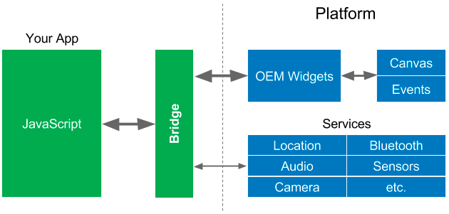
ReactNative

Slide 70
ReactNative
Poor Compatibility
Lack Security Robustness
Poor Memory Management

Slide 71


Slide 72
Flutter
https://flutter.io/

Slide 73
Flutter
Flutter allows you to build beautiful native apps on iOS and Android from a single codebase.

Slide 74
Dart
class MyApp extends StatelessWidget { @override Widget build(BuildContext context) { return Container( decoration: BoxDecoration(color: Colors.white), child: Center( child: Text( 'Hello World', textDirection: TextDirection.ltr, style: TextStyle( fontSize: 32.0, color: Colors.black87, ), ), ), ); } }

Slide 75
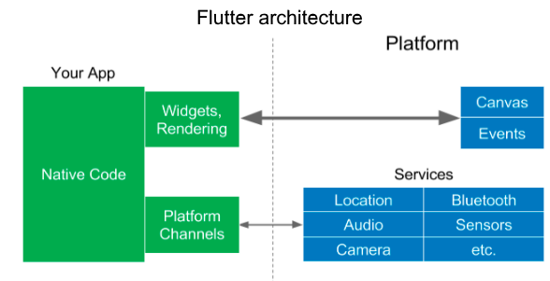
Flutter

Slide 76
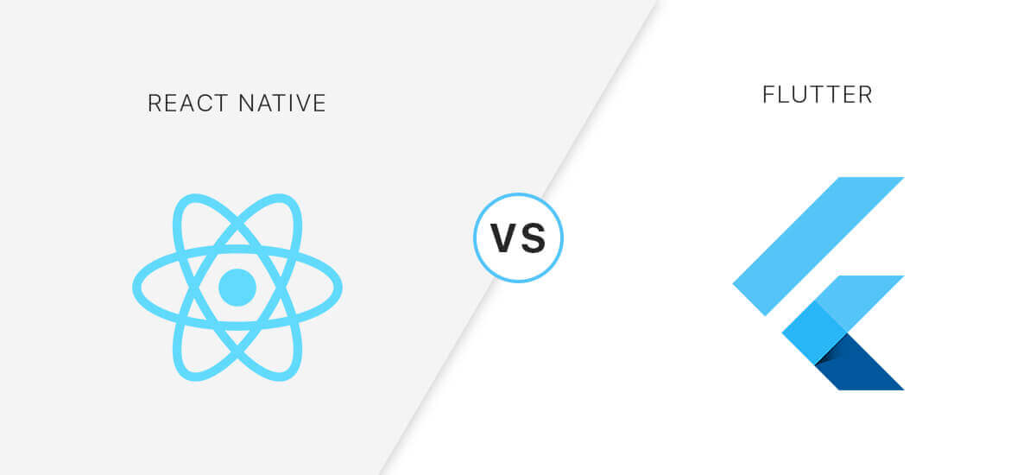

Slide 77
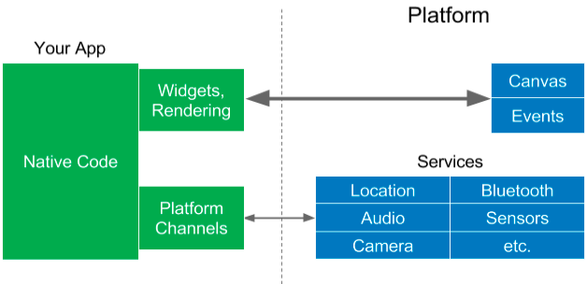
Flutter

Slide 78
Flutter
Fast Development
Expressive and Flexible UI
Native Performance

Slide 79
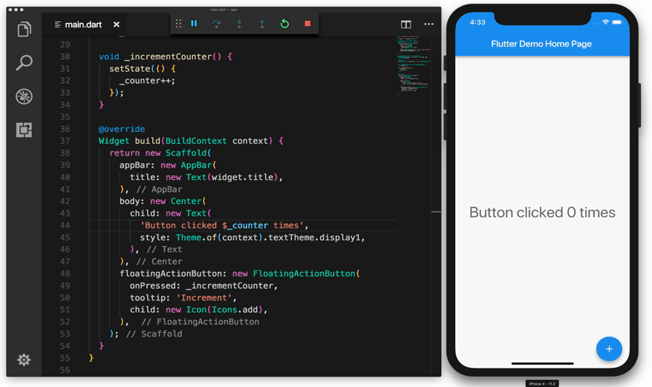
Hot Reload

Slide 80
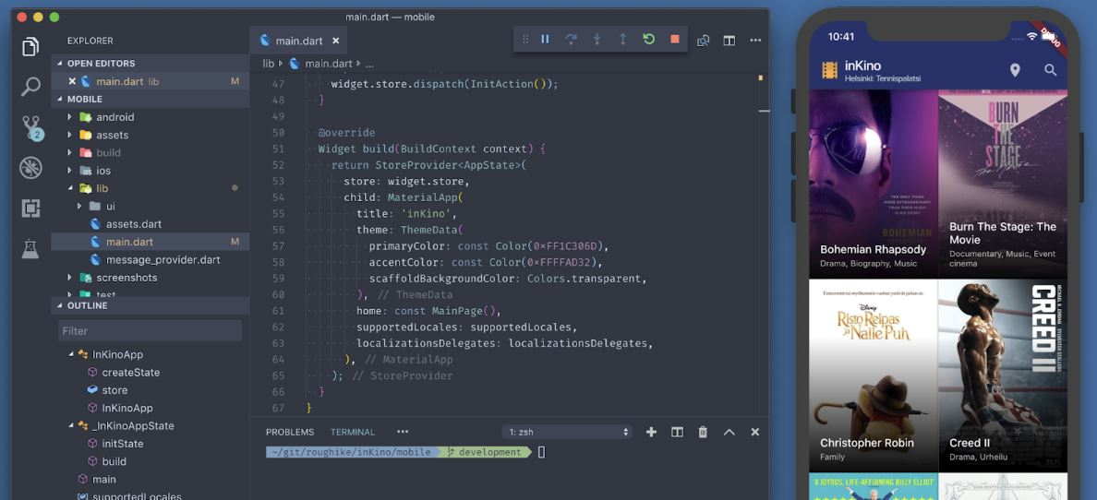
Flexible UI

Slide 81
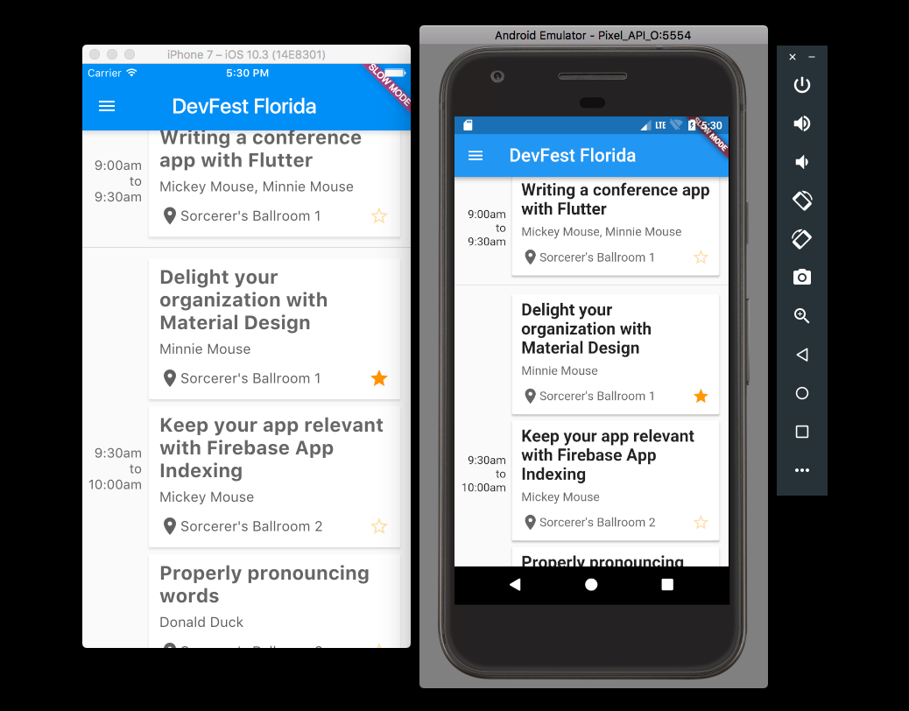
Cross-Platform

Slide 82

THANKS.

